Slide 1
Preliminary Due-Diligence Study of the
Carson District Silver & Gold Mines
Hinsdale County, Colorado
Version 2023-11-07
Talk Date at DMC Luncheon: 2023-06-05
Senior Author & Geologist: Lindsey V. Maness, Jr.
Speaker & Miner: Suellen Barnhard

Slide 2
Acknowledgments
Miller, Victor C. (deceased), and Miller, Calvin, F. (deceased), 1961, PHOTOGEOLOGY, McGraw-Hill Book Company, Inc., New York, 248 pp. (out of print)
  This Study would not have been possible without Vic’s text book.
Lee Van Maness, U.S. Forest Service (USFS)
  Solved Many Software & Hardware Problems
Jacob … USGS/EROS Data Center
  Solved Some of the Problems with EROS Data Center Software
John C. Hopkins Colorado Geological Survey (CGS)
  Assisted in Acquiring CGS OF-1-20
Mrs. Sherry Boyce, Hinsdale County Assessor
  Provided Information About Land Owner from the Hinsdale County Web-Site
Denver Mining Club (DMC) Officers
  Advice and Suggestions

Slide 3
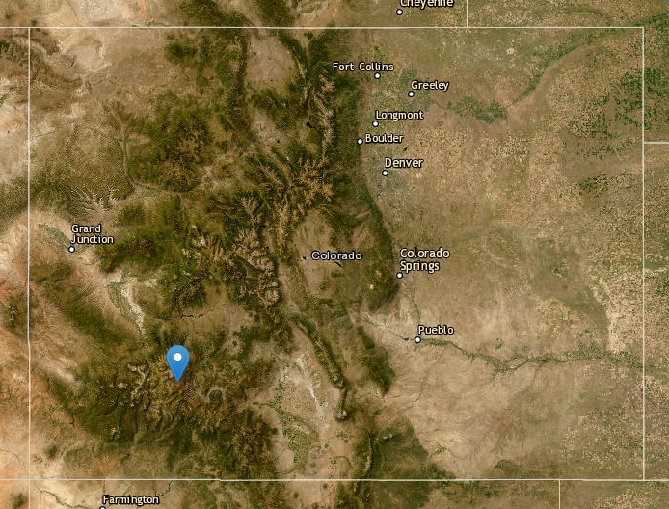
Colorado: Carson Mine Indicated

Slide 4
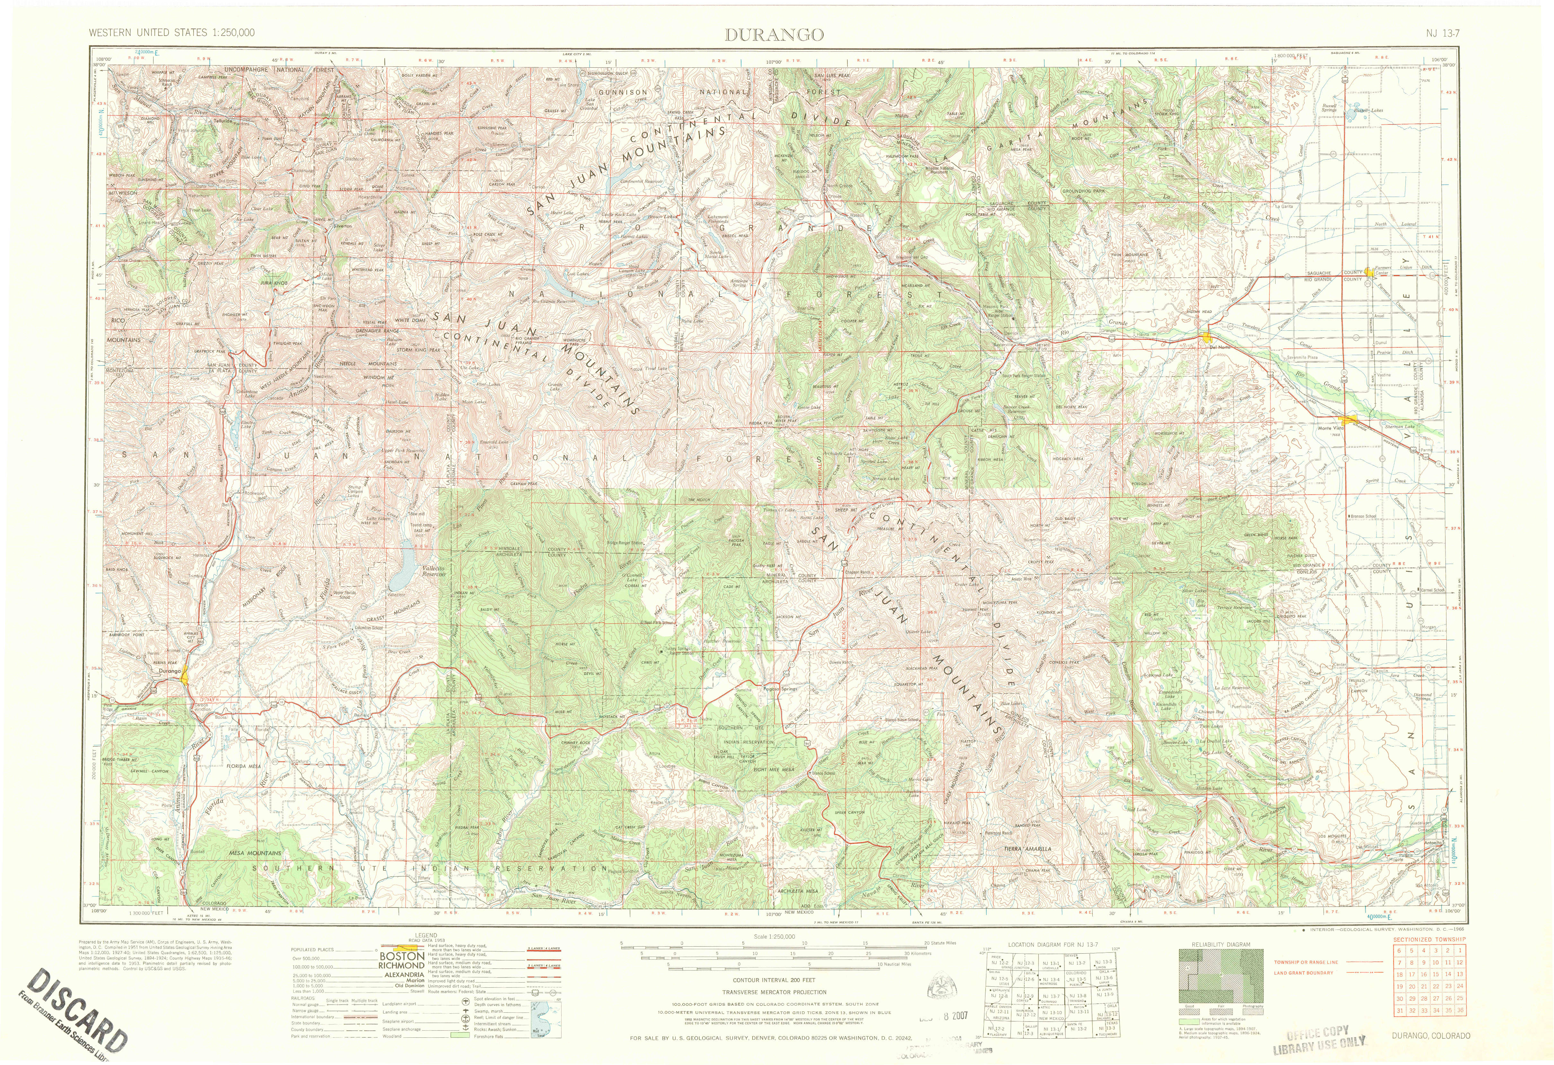
Durango Topo 1966 1:250,000

Slide 5
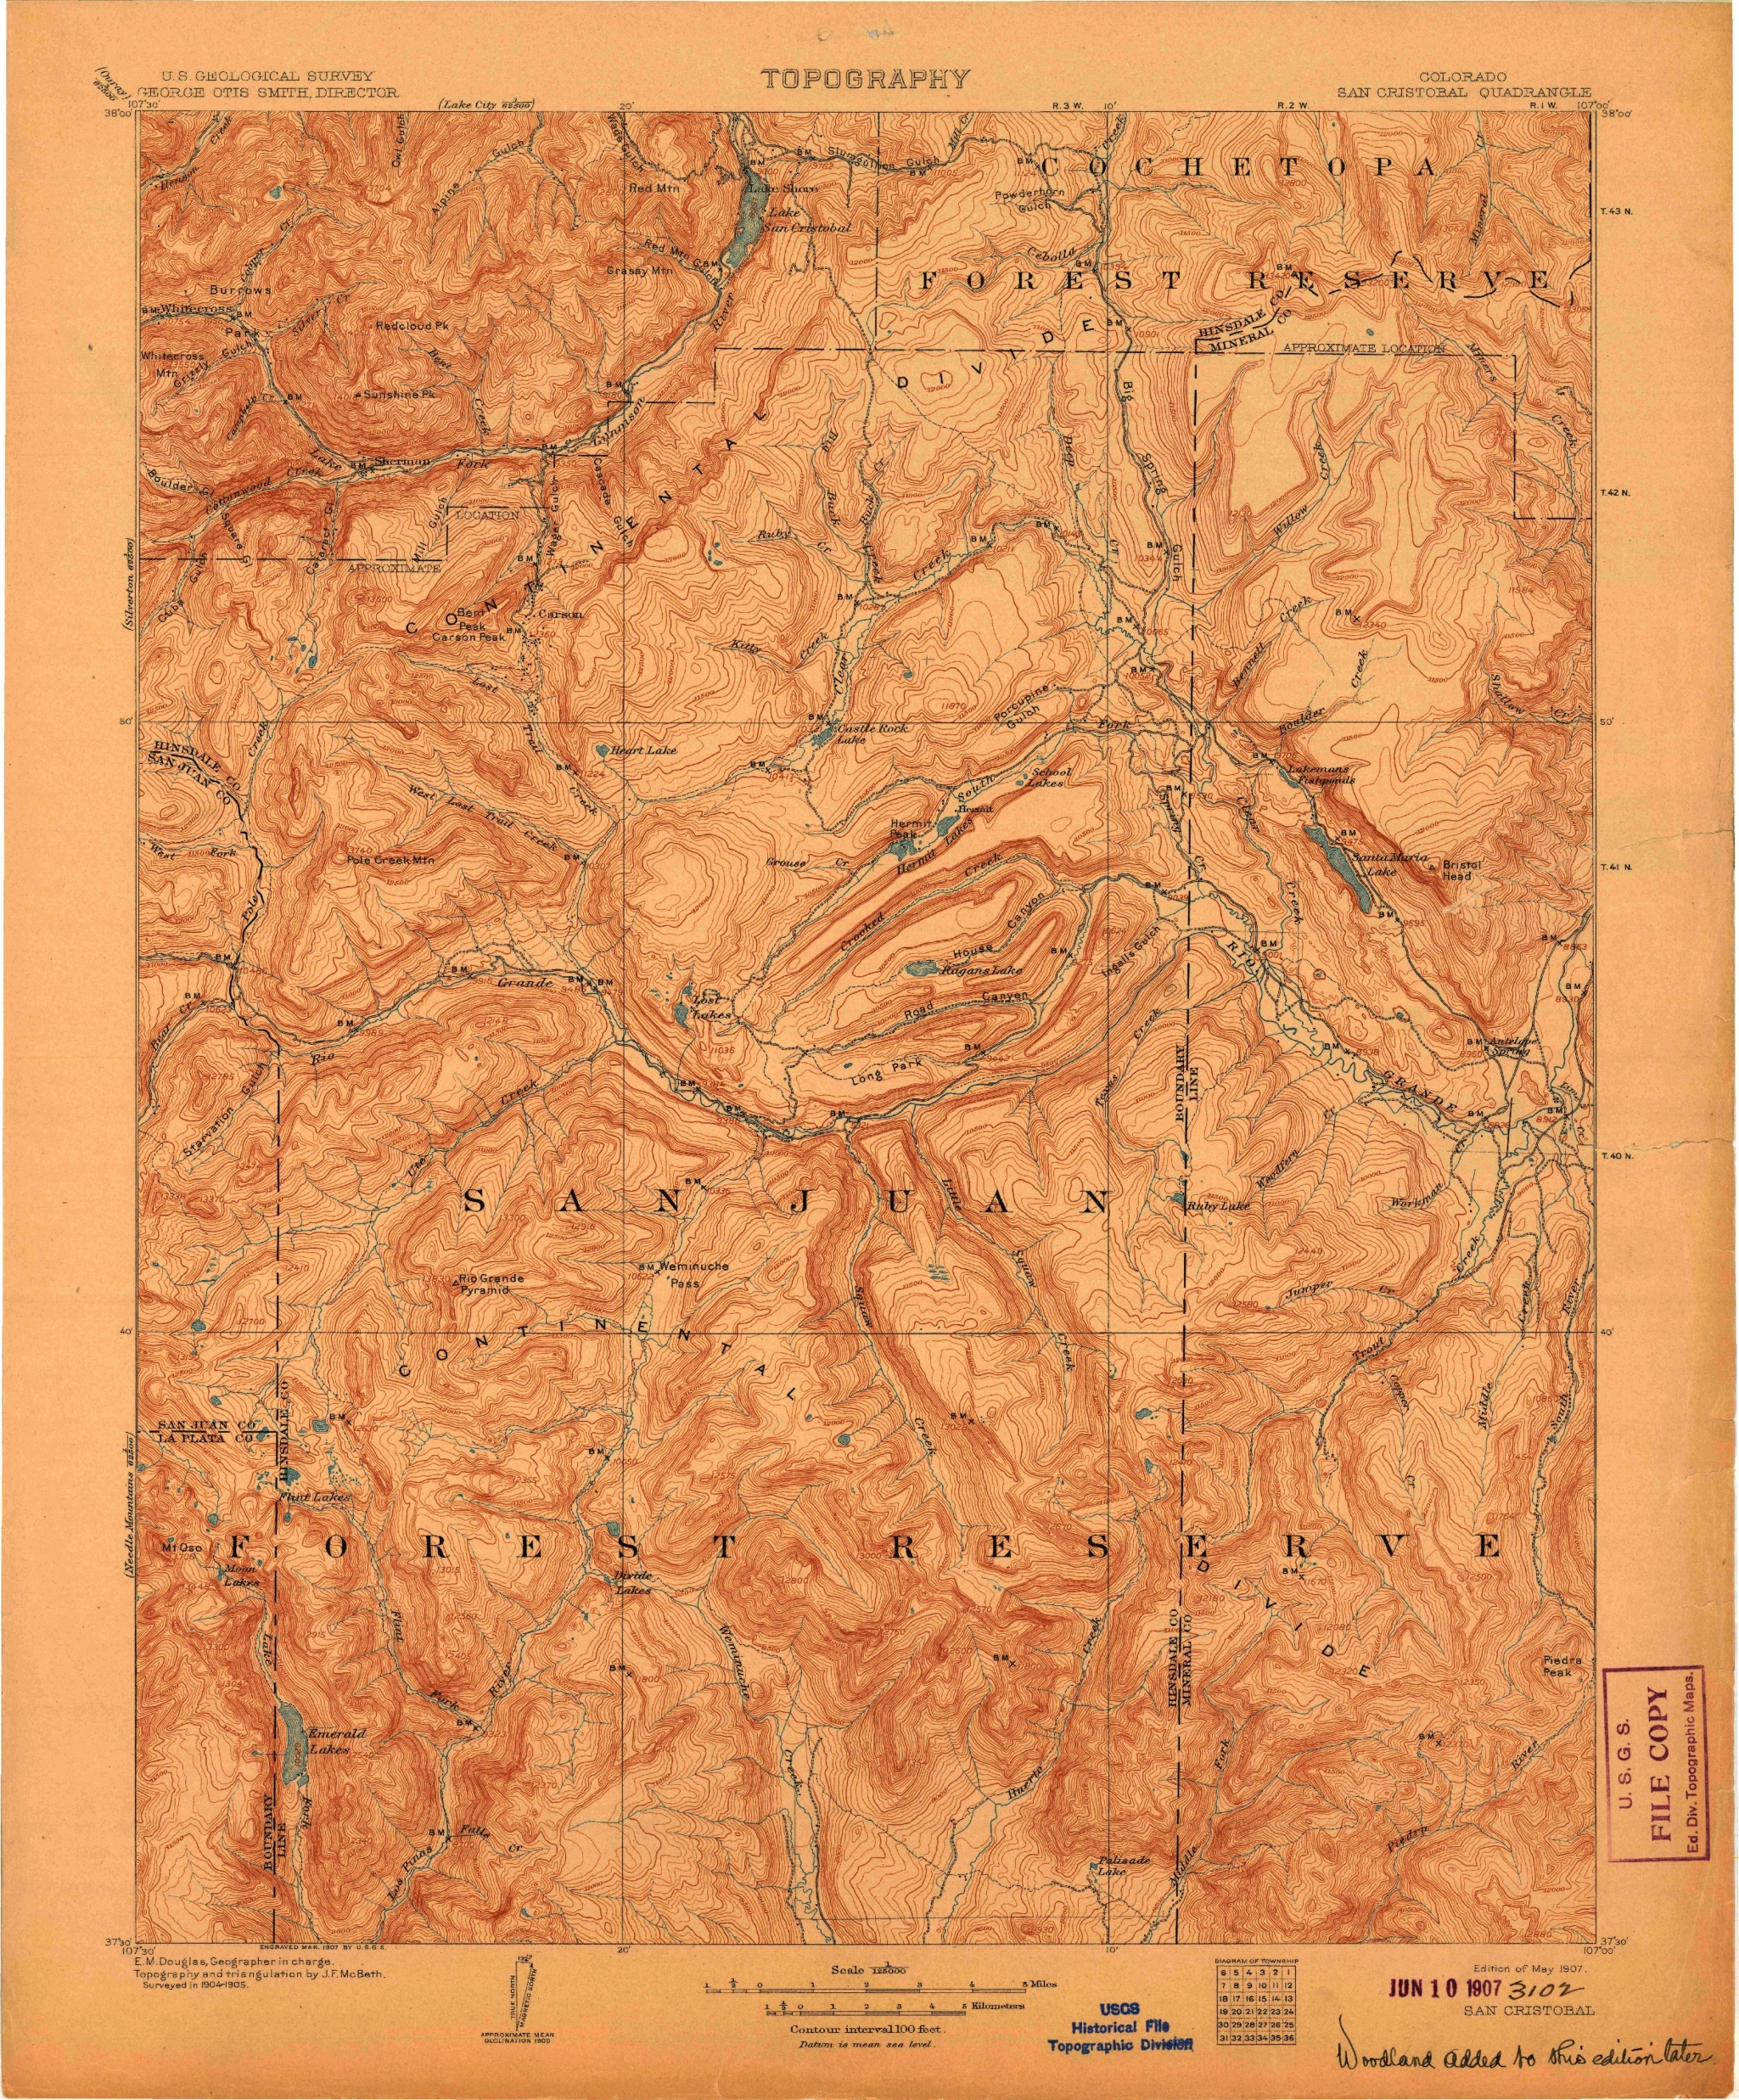
San Cristobal Topo 1907 1:125,000

Slide 6
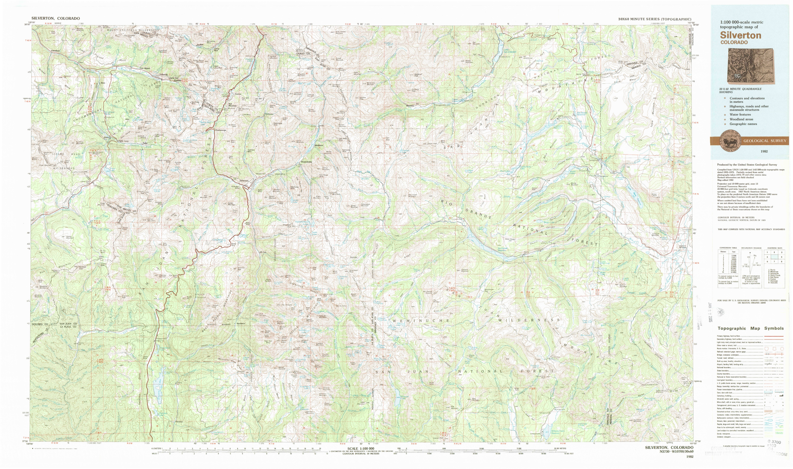
Silverton Topo 1982 1:100,000

Slide 7
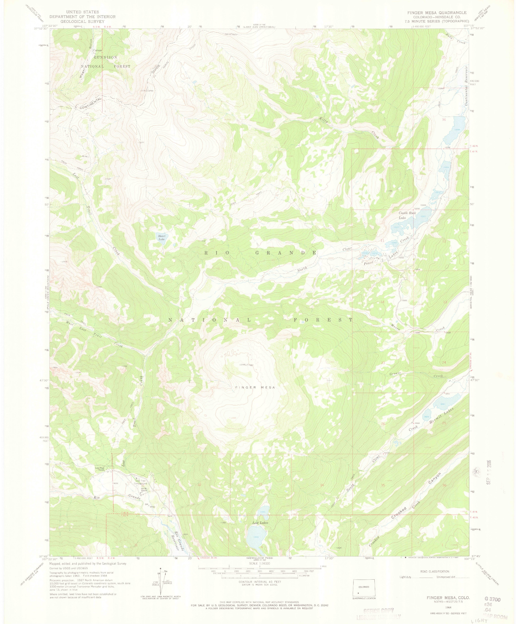
Finger Mesa Topo 1964 1:24,000

Slide 8
Aerial Photo: Carson

Slide 9
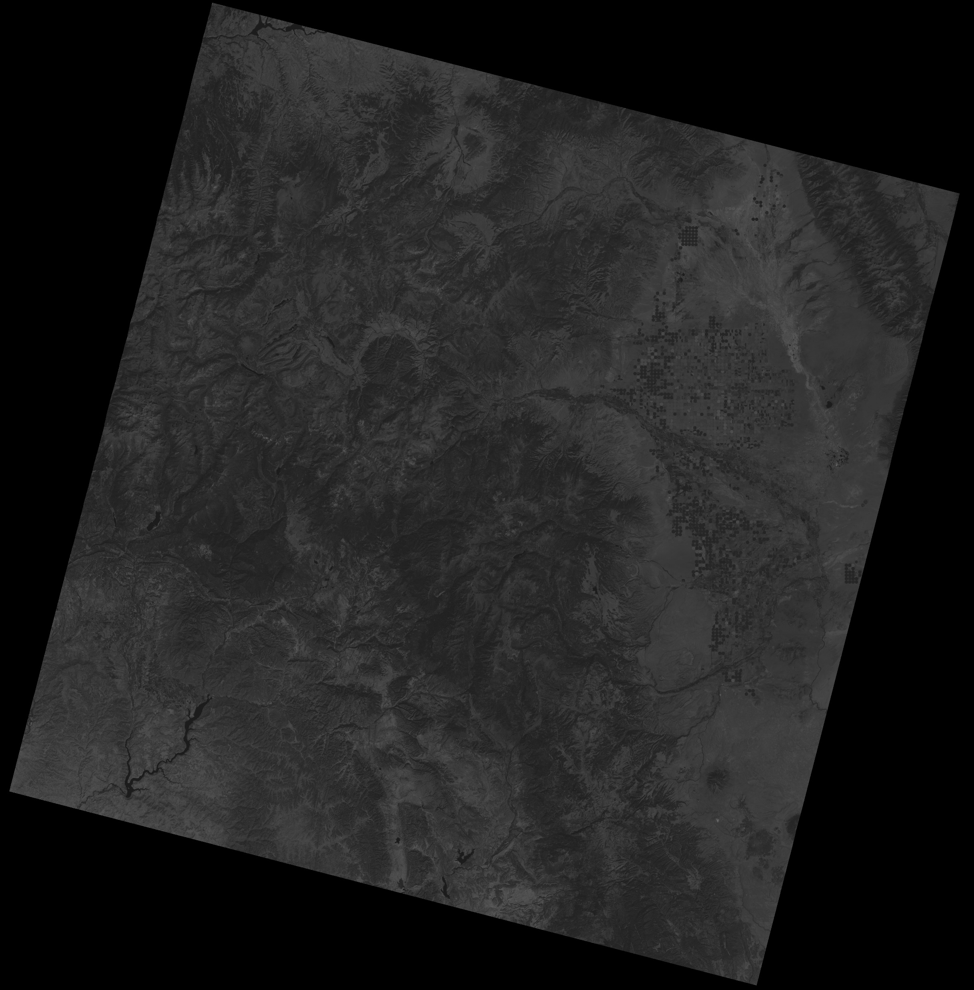
Landsat TM Image of Carson

Slide 10
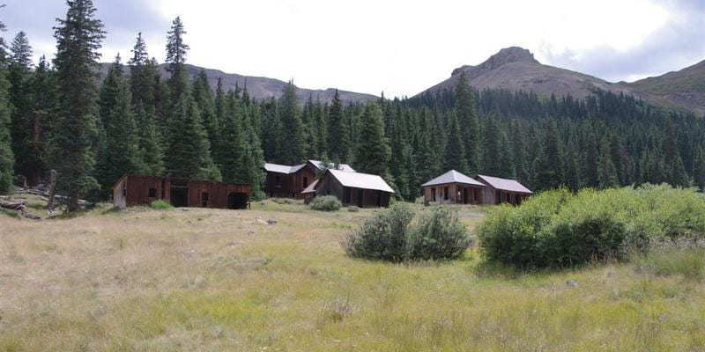
Carson Photo

Slide 11
Circumstances
Client Asks:
“What do you think about … mining property?”
“Is it worth looking at more closely?”
Reply:
“I will find out what information exists, organize and evaluate it and get back to you with a look-see type summary.”
“Then you can decide whether to do more detailed work, including photogeological, geological, geochemical, geophysical, coring, sampling and other work.”

Slide 12
Types of Information
Who
What
When
Where
Why
To What Degree
How
Value

Slide 13
Who
The Present Owner is Carson Gold and Silver Joint Venture, c/o Betty Shoppa, 301 Watermere Drive, #104, Southlake, TX 76092-8131, Tel.: 817-868-1866 (former), E-Mail: BShoppa@Shoppa.com. As of 2023-03-06, it was contracted to be sold to an Unidentified Buyer. Apparently, delays have prevented the sale. Has not Responded to Inquiry.
Who was the Immediate Past Owner?
Title History, from beginning to present

Slide 14
What
The Carson District Mines
Silver (primarily)
Gold (secondary)
Other Minerals of Value containing Lead-Zinc, Copper, …
Probably Strategic Minerals, in particular REE present
Other Items Produced, with Comments
Large Areas of Mine Waste with Good Potential for Reworking
Possible Carson Geothermal Field

Slide 15
What, Continued
Temperatures
  Summer
  Winter
Rain
Other More Detailed Studies

Slide 16
When
Mined From the 1880s to the 1940s. Apparently, the mines closed because the underground ore was worked out, so the potential for profit from reopening the underground workings is slight. Officially, the reason given is that the value of silver fell, but this is clearly disingenuous since the mines were struggling before the prices fell. The extensive mine waste dumps have good to excellent potential for profitable reworking, primarily for silver, gold and copper.

Slide 17
Where
Hinsdale County, Colorado
Ghost Town of Carson
~16 miles SW of Lake City
T42N R5W
37ᵒ 52’ 9” N Latitude by 107ᵒ 21’ 43” W Longitude Elevation …
Zip Code: None Listed
In San Juan Volcanic Field near Needle Mountain

Slide 18
Where, Continued
CGS Maps & Information
  OF-1-20 Report. Includes Carson region.
DOD Maps
  1:50,000 Scale = Intermittent See EROS. None of Carson.
  Other Countries (Spy Photos) See EROS. None of Carson.
USGS Maps
  1:250,000 Scale = All. Durango includes Carson.
  1:125,000 Scale = Some. 30’ x 30’ San Cristobal includes Carson.
  1:100,000 Scale = All, Intermittent. Silverton includes Carson.
  1:63,360 Scale = All, Intermittent. ?
  1:48,000 Scale = All, Intermittent. ?
  1:25,000 Scale = Alaska. None of Carson.
  1:24,000 Scale = All Except Alaska. Finger Mesa includes Carson

Slide 19
Why
The prices for gold, silver and copper are very high at present, but somewhat volatile.
During much of the time period of active operation, many hard-rock precious metals mines extracted only about 30% of the commodities present. The remaining 70% in the wastes, if extractable, could be more profitable than the original mines were.
Though isolated at the end of a poorly-maintained dirt road, in an area notorious for inclement (cold) weather, the mines were among the largest in Colorado.
Cost benefits include already Milled, Accessible Above Ground, …
Aggregate from Quartz Mine Waste would be easy to Remediate and have Value
Area is not historically overtly hostile to mining and would probably welcome new jobs from mining.
The original facilities are largely intact, but lack access to utilities.

Slide 20
To What Degree
Underground is Probably Worked-Out
Potential for World-Class Mineralization at Depth
  If Batholiths and/or Sills were and are Mineralized Source Rocks
  If it is at a Minable Depth
Extensive Waste Dumps Probably Have Substantial Value
Reopening Will Probably Cost on the Order of $30 millions. See Batchelor Mine.
The property is in the San Juan Volcanic Field. Most of the value came from Silver, with Gold a close second. Copper was minor, but extracted, probably as a smelting by-product owned by the smelter. Lead and Zinc Sulfides were produced in large quantities, but apparently again owned by the smelter.

Slide 21
How
Conventional Reworking/Remediation is Possible.
New Procedures and Techniques Developed by Lindsey Maness in pursuit of the goal of “No-Waste Mining” Might Prove Desirable.
Encouragement for Remediation from the EPA, from other Federal, State and Local Agencies, as well as the Public might prove to be the case. The Ore was mined from Quartz Dikes that intruded the Volcanics. That is why the mine dumps are so white! High quartz waste is easily cleaned and valuable as aggregate.
Exploration Methods for Quartz Dikes Include:
  Stereoscopic Photogeology
  Drilling for Cores
  Seismic
  Ground Penetrating Radar (GPR)

Slide 22
How, Continued
Avoid Possible Conflicts-of-Interest Associations
  University Involvement Should be Kept to a Minimum.
  University Owned Corporations should be Avoided.
  Non-Profits in General should be Avoided.
  Anyone with a Political Axe to Grind should be Avoided.

Slide 23
Value
At this preliminary stage, the Value will be “Go or No Go” to a formal, detailed Due-Diligence determination.
Hinsdale County has assigned a Value for Tax Purposes, but this type of valuation is seldom the actual, true value. Legalities, including Easements, whether or not the Title is Clear, etc., are important. Assets vs. Liabilities (including Environmental) are important. Contact: Hinsdale County Assessor, Mrs. Sherry Boyce, Tel.: 970-944-2225 X 140, E-Mail: Assessor@HinsdaleCountyColorado.US My limited experience with Mrs. Boyce has been quite positive: she has been helpful, professional, courteous and offered advice freely; however, Mrs. Boyce was very careful to honor the privacy of all involved parties and declined to discuss certain matters.
The True Value is obtainable only by conducting a Detailed Due-Diligence Evaluation that Includes Coring, Sampling, Geological, Geochemical, Geophysical and Other Disciplines. That is beyond the scope of this talk.

Slide 24
Value, Continued
Proximity to Many Mine Waste Dumps May Cause Real Estate Value to be Net Negative!
Removal of Mine Waste Dumps Would Result in far-higher Normal Values

Slide 25
Acquisition of Information (Public Domain)
US Bureau of Land Management (BLM).
US Department of Defense (National Geospatial Intelligence Agency [GIA])
US Department of Energy (in particular the NURE maps & reports)
USGS (Censors to meet in-house PC Standards)
  MRDS & MILS Data Bases (Direct Access to Data Base for copying, etc., Prevented, even though in the Public Domain. Good Luck getting these!)
  Standard Publications: Folio, GP, GQ, I, MF, OF (OFR), PP (P) Reports, etc.
  US Bureau of Mines Reports, etc.
  USGS is Building an Empire by Replicating the products of other government agencies, in particular of the Dept. of Agriculture, Soil & Conservation Service.
EROS Data Center
  Landsat Images
  Aerial Photographs (NHAP, NAIP, NAPP, … Other Agencies [i.e., SCS], DOD Photos of Other Countries)
US National Aeronautics and Space Administration (NASA)
  Landsat Experiments
  Heat Capacity Mapping Mission (HCMM) Experiments
  IFSAR Experiments
  SIR-C Radar Imaging Mission Experiments
  Others (many types)
US Soil & Conservation Service (SCS) [Often has old air photos from when mines were active]. The SCS also gives the option of ordering by Townships, Ranges and Sections, something the USGS/EROS should offer!
National Mine Map Repository (NMMR)
US Environmental Protection Agency (EPA)
US Securities and Exchange Commission (SEC)

Slide 26
Acquisition …, Continued, p. 2
Colorado Geological Survey (Now Part of CSM). Note that the CGS has a .org (not .gov) website and its employees have a .edu email address!
Universities
  Theses and Dissertations can be excellent sources!
University Consultants and Corporations
  Be Careful of Potential Conflicts-of-Interest!
Trade Journals, like Geology, Geotimes, SME Journal, …
Media
  The Denver Post
  The Rocky Mountain News (Archives)
  High Country News
Mindat.org web-site

Slide 27
Acquisition Continued, p. 3
Geoscience World
HistoryColorado.org
Denver Region Exploration Geologists (DREGS)
Google Earth Pro to Get Local Photos along roads
Anecdotal Photos, including Historical

Slide 28
Purposes of Due-Diligence Mine Study
Determine General Likelihood of Profit
Gather Verifiable Information to be used in an NI43-101 for Investors

Slide 29
Ore Mineralogy, etc.
Barite BaSO₄
Chalcopyrite CuFeS₂
Copper Cu (Native: anecdotal)
Enargite Cu₃AsS₄
Famatinite (aka Fematinite) Cu₃SbS₄
Gold Au
Galena PbS (Argentiferous and Auriferous)
Gold Au (Native, magnificent crystals: anecdotal)
Silver Ag (Native, crystals?: anecdotal)
Note: Famatinite (Fematinite) substitutes Sb for the As in Enargite.

Slide 30
Hydrothermal Alteration (Indicator Minerals)
Alunite KAl₃(SO₄)₂(OH)₆
Kaolinite Al₂O₃(SiO₂)₂(H₂O)₂ Also a common low temperature mineral.
Marcasite FeS₂
Pyrite (Massive) FeS₂
Quartz (Massive) SiO₂
Sericite KAl[AlSi₃O₁₀](OH)₂ A kind of muscovite, usually with very fine flakes.
Sphalerite [Zn, Fe]S (Argentiferous and Auriferous) With high temperatures, the Fe can increase to 40%!

Slide 31
Gangue
Andesites …
Biotite …
Hornblende …
Orthoclase …
Plagioclase …
Rhyolites …
Quartz Latites …

Slide 32
Calculating Troy Ounces per Ton & Value
Get per Ton Values for Commodities. A Rail Car is generally the value quoted. It is 2 tons, so must be halved.
Calculate, based on each commodity or formula, the value amount as an Economic Unit value which can be proportionally adjusted to match True Value. In the Carson City example, one ton of ore was quoted as being worth $50-$500. An ounce of gold was accompanied by 100 ounces of silver, so the Economic Unit value is the price of gold plus 100 ounces of silver at a given time prorated accordingly. In 1900, the value of 1 Troy Ounce of gold was $20.67; the value of 100 Troy Ounces of silver was $62.01, so the Economic Unit price was $20.67 + $62.01 = $82.68.

Slide 33
Calculating Troy Ounces per Ton & Value, p. 2
Next, we need to determine the percentages of each by value.
Gold: $20.67/$82.68 = 25% of total Economic Unit
Silver: $62.01/$82.68 = 75% of total Economic Unit
Next, we need to determine the total value per ton for each.
Gold is 25% of the total value = for $50/ton - $500/ton = $12.50 - $125/ton.
Silver is 75% of the total value = for $50/ton - $500/ton = $37.50 - $375.00/ton.

Slide 34
Calculating Troy Ounces per Ton & Value, p. 3
Next, we calculate the Grade (or Tenor), the total number of Troy Ounces per ton. Divide the value/ton of ore by the value per ounce.
Au $12.50/$20.67 to $125.00/$20.67 = 0.6-6.05 Troy Ounces/ton.
Ag $37.50/$0.62007 to $375.00/$0.62007 = 60.48-604.77 Troy Ounces/ton.
If we want to calculate the values of additional commodities, we just repeat this process for each commodity (e.g., Cu, Pb, Zn, S …). Note that with additional commodities the total value of one ton of ore increases but the value of each previously calculated commodity and the Grade for each stays the same. It is relative to the added value per ton to each commodity of interest.

Slide 35
Possible Carson Geothermal Field
Inadequate Information to Assign Value
If present, would be more valuable than the existing mine
Some Indicators for Possible Geothermal Energy Field(s)
  Hydrothermal Minerals Suite
  Calderas: Carson, Lake City, San Juan, Silverton, Uncompahgre, …
  Hot Springs in Area
  Silica & Sulfide filled Fractures in former Mine
Must be Proven: at Present Only Geologically Favorable/Speculative

Slide 36
Go or No Go Recommendations for doing Detailed Due-Diligence
No Go Reopen Carson Underground Mines
Go Carson Waste Dumps Reworking/Remediation
Go Carson Open Pit Mine
Go Carson Combined Open Pit and Reworking
Go Carson Geothermal Field

